Slide 1

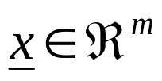
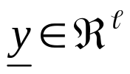
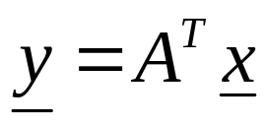

Optimal Feature Generation
In general, feature generation is a problem-dependent task. However, there are a few general directions common in a number of applications. We focus on three such alternatives.
  Optimized features based on Scatter matrices (Fisher’s linear discrimination).
    The goal: Given an original set of m measurements
    , compute , by the linear transformation
    so that the J₃ scattering matrix criterion involving S_{w}, S_{b} is maximized. A^{T} is an matrix.

Slide 2
    The basic steps in the proof:
      J₃ = trace{S_{w}⁻¹ S_{m}}
      S_{yw} = A^{T}S_{xw}A, S_{yb} = A^{T}S_{xb}A,
      J₃(A)=trace{(A^{T}S_{xw}A)⁻¹ (A^{T}S_{xb}A)}
      Compute A so that J₃(A) is maximum.
    The solution:
      Let B be the matrix that diagonalizes simultaneously matrices S_{yw}, S_{yb} , i.e:
      B^{T}S_{yw}B = I , B^{T}S_{yb}B = D
      where B is a ℓxℓ matrix and D a ℓxℓ diagonal matrix.

Slide 3
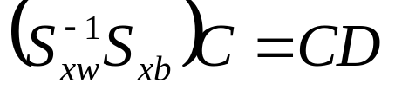
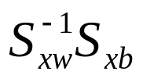
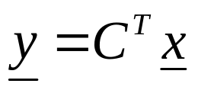
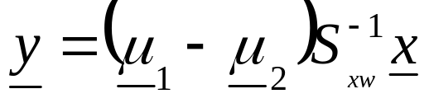
      Let C=AB an mxℓ matrix. If A maximizes J₃(A) then
      The above is an eigenvalue-eigenvector problem. For an M-class problem, is of rank M-1.
        If ℓ=M-1, choose C to consist of the M-1 eigenvectors, corresponding to the non-zero eigenvalues.
        The above guarantees maximum J₃ value. In this case: J_{3,x} = J_{3,y}.
        For a two-class problem, this results to the well known Fisher’s linear discriminant
        For Gaussian classes, this is the optimal Bayesian classifier, with a difference of a threshold value .

Slide 4


        If ℓ<M-1, choose the ℓ eigenvectors corresponding to the ℓ largest eigenvectors.
        In this case, J_{3,y}<J_{3,x}, that is there is loss of information.
      Geometric interpretation. The vector is the projection of onto the subspace spanned by the eigenvectors of .

Slide 5
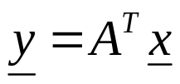


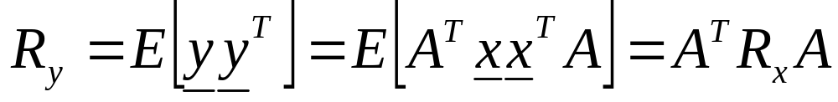
  Principal Components Analysis
  (The Karhunen – Loève transform):
    The goal: Given an original set of m measurements
    compute
    for an orthogonal A, so that the elements of are optimally mutually uncorrelated.
    That is
    Sketch of the proof:

Slide 6

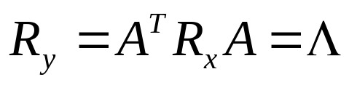
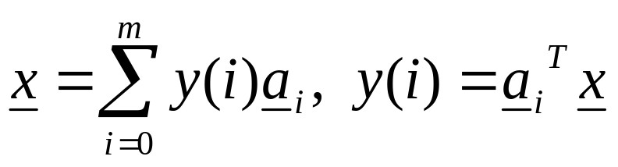
      If A is chosen so that its columns are the orthogonal eigenvectors of R_{x}, then
      where Λ is diagonal with elements the respective eigenvalues λ_{i}.
      Observe that this is a sufficient condition but not necessary. It imposes a specific orthogonal structure on A.
    Properties of the solution
      Mean Square Error approximation.
      Due to the orthogonality of A:

Slide 7
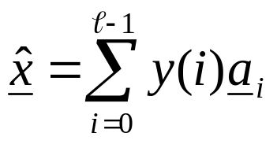
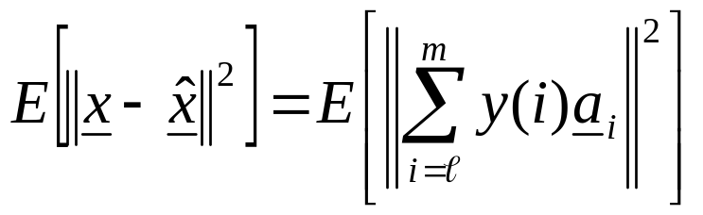
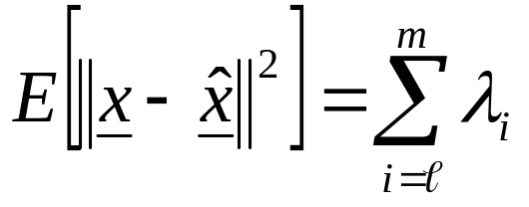
        Define
        The Karhunen – Loève transform minimizes the square error:
        The error is:
      It can be also shown that this is the minimum mean square error compared to any other representation of x by an ℓ-dimensional vector.

Slide 8


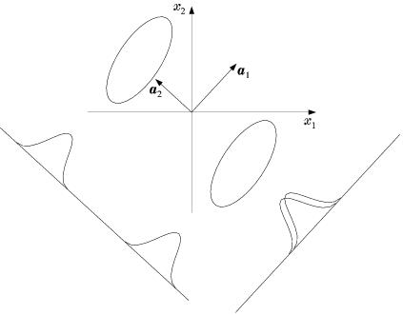
        In other words, is the projection of into the subspace spanned by the principal ℓ eigenvectors. However, for Pattern Recognition this is not the always the best solution.

Slide 9
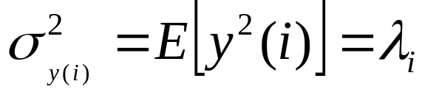

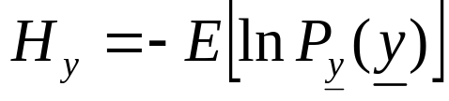
      Total variance: It is easily seen that
      Thus Karhunen – Loève transform makes the total variance maximum.
      Assuming to be a zero mean multivariate Gaussian, then the K-L transform maximizes the entropy:
      of the resulting process.

Slide 10

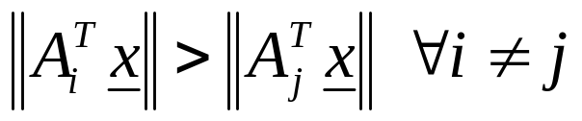
  Subspace Classification. Following the idea of projecting in a subspace, the subspace classification classifies an unknown to the class whose subspace is closer to .
  The following steps are in order:
    For each class, estimate the autocorrelation matrix R_{i}, and compute the m largest eigenvalues. Form A_{i}, by using respective eigenvectors as columns.
    Classify to the class ω_{i}, for which the norm of the subspace projection is maximum
    According to Pythagoras theorem, this corresponds to the subspace to which is closer.

Slide 11
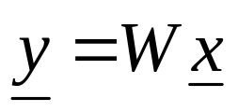


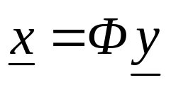
Independent Component Analysis (ICA)
In contrast to PCA, where the goal was to produce uncorrelated features, the goal in ICA is to produce statistically independent features. This is a much stronger requirement, involving higher to second order statistics. In this way, one may overcome the problems of PCA, as exposed before.
  The goal: Given , compute
  so that the components of are statistically independent. In order the problem to have a solution, the following assumptions must be valid:
    Assume that is indeed generated by a linear combination of independent components

Slide 12
    Φ is known as the mixing matrix and W as the demixing matrix.
    Φ must be invertible or of full column rank.
    Identifiability condition: All independent components, y(i), must be non-Gaussian. Thus, in contrast to PCA that can always be performed, ICA is meaningful for non-Gaussian variables.
    Under the above assumptions, y(i)’s can be uniquely estimated, within a scalar factor.

Slide 13


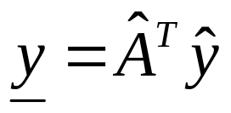
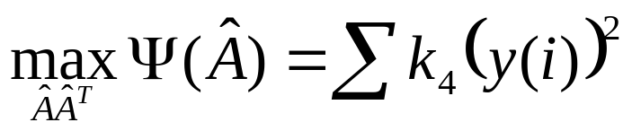

  Common’s method: Given , and under the previously stated assumptions, the following steps are adopted:
    Step 1: Perform PCA on :
    Step 2: Compute a unitary matrix, , so that the fourth order cross-cummulants of the transform vector
    are zero. This is equivalent to searching for an that makes the squares of the auto-cummulants maximum,
    where, is the 4th order auto-cumulant.

Slide 14
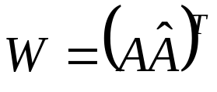
    Step 3:
  A hierarchy of components: which ℓ to use? In PCA one chooses the principal ones. In ICA one can choose the ones with the least resemblance to the Gaussian pdf.

Slide 15
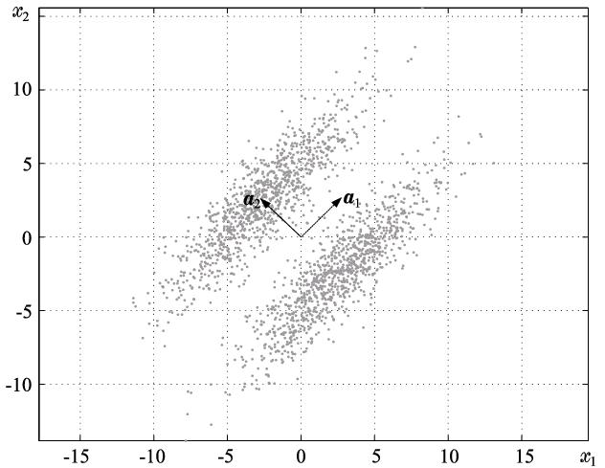




  Example:
The principal component is , thus according to PCA one chooses as y the projection of into . According to ICA, one chooses as y the projection on . This is the least Gaussian. Indeed:
K₄(y₁) = -1.7
K₄(y₂) = 0.1
Observe that across , the statistics is bimodal. That is, no resemblance to Gaussian.

